Slide 1

ALY 6000​ Module 5 Project
Data Analytics Industry Report
Sunil Raj THOTA NUID: 001099670

Slide 2
Overview of Retail Industry​
This chart depicts that the most preferred technologies used by retail companies are Data Visualization, Location-based, Big Data, In-store Sensors, and ML/ AI to stay on top of the game and gain huge share in the markets.
This also makes them to be one step ahead.
This pie chart shows the companies investing in various strategies to make their existence in this market.
Few to name are making more personalization recommendations, increasing the in-store experience, and by making customer experience better in all ways.
1 Big Data Analytics in Retail Market - Growth, Trends and Forecast (2020 - 2025), https://www.mordorintelligence.com/industry-reports/big-data-analytics-in-retail-marketing-market

Slide 3














Skills & Tools of Data Analyst​
SQL Python MS Excel
Business Acumen Critical Thinking
Social Media Customer Service Finance
Logistics
AWS Machine Learning Hadoop
Research Communication Skills
2 8 skills you’ll need for your future retail career by Kate Lopaze, https://www.thejobnetwork.com/8-skills-youll-need-future-retail-career/

Slide 4
Market Analysis of Retail Analytics​
These charts and graphs shows the market analysis of the Retail industry and the use of Big Data Analytics in it.
The highest share in this market is Electronics and Apparel with almost 46% and trend has been increasing exponentially from the year 2016 to 2020 and it is predicted to be around 4.5 Billions USD by 2025.
This occurs and will reach to new milestones in coming years. Retail industry was mainly influenced b the younger generation from 18 to 34 years age people and allocating almost 75 to 80 % of their purchasing.
3 Disruptions in Retail through Digital Transformation Reimagining the Store of the Future by S Kannan, https://www2.deloitte.com/content/dam/Deloitte/in/Documents/CIP/in-cip-disruptions-in-retail-noexp.pdf

Slide 5
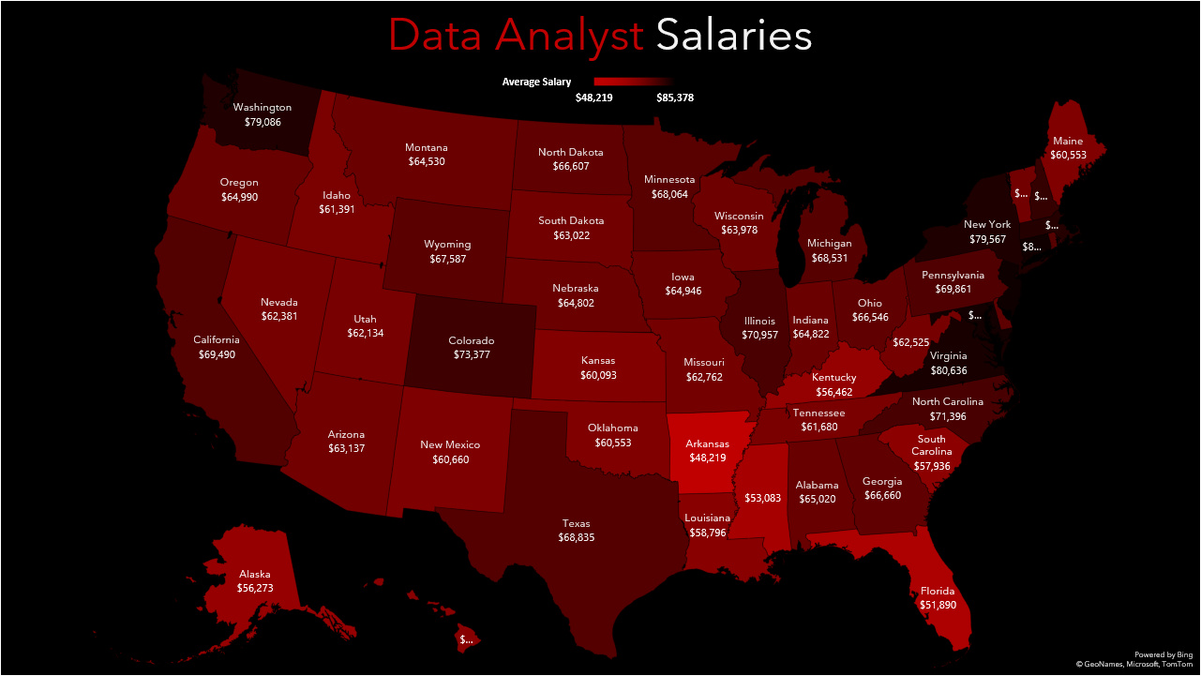

Slide 6
Conclusion
Big Data Analytics is playing and will definitely plays a vital part in determining the upcoming retail industry.
The big data revolution is going to set new standards and will become the future of retail and other industries.
The use of statistics and visualization in the fields of Data Analytics and its related networks are unprecedently becoming the go to word for all the businesses and companies.
An efficient supply chain, an enhanced drive of goods from dealers to silos to stores to the shopper, is very serious in every business.
So, big data analytics is so essential of transforming retail industry and excels in real-time, leveraging customer data to envisage purchasing forms.
These charts helps a person to understand better and clear about the insights drawn from the data Excel and R are one of basic building blocks to start with and also these tools are in high in demand

